Slide 1
Records (structs) D.S Malik Book Chapter 11
Object oriented Programming
Spring 2024

Slide 2
C++ data types
Simple
Structured
Arrays (collection of homogenous elements)
E.g., String: collection of characters
Records (Structs) (collection of heterogeneous elements)
Union
class

Slide 3
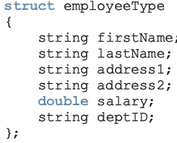
Records(structs)
Each value is a collection of components items
Entire collection is given a name (user defined data type)
Each component can still be accessed individually

Slide 4
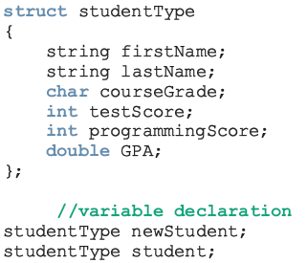
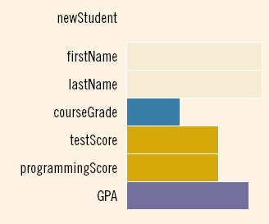
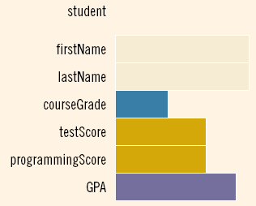
Variable declaration

Slide 5

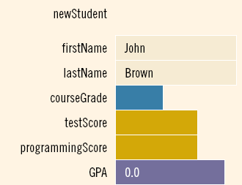

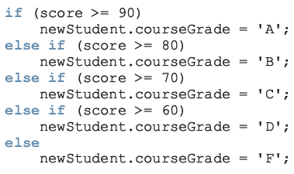
Accessing elements of struct
Example:
int score;

Slide 6

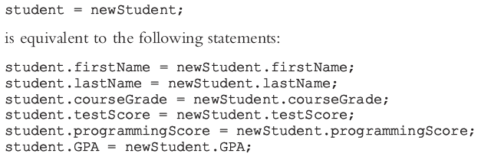
Assignment operator for structs
We can assign the value of one struct variable to another struct variable of the same type by using an assignment statement

Slide 7
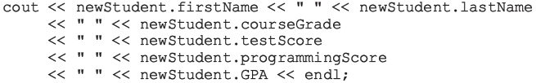
Comparison is done element by element
No aggregate input/output is allowed
cin>>newStudent; // illegal
cout<<newStudent; // illegal

Slide 8
Example: Student Report
#include <iostream>
#include <string>
using namespace std;
struct StudentReport
{
string st_name;
int marks;
char grade;
};
void main()
{
StudentReport s1,s2;
cout<<“\n Enter details of student \n”;
cin>>s1.st_name>>s1.marks>>s1.grade;
s2=s1;
}

Slide 9
Structs and functions
Arrays are passed by reference only and a function cannot return a value of type array
A struct variable can be passed as a parameter either by value or by reference
A function can return a value of type struct

Slide 10
Example: Student Report contd.
void ReadReport(StudentReport &s)
{
cout<<"\nEnter Student's name: ";
cin>>s.st_name;
cout<<"\nEnter Marks of student, out of 100: ";
cin>>s.marks;
s.grade=Calc_Grade(s.marks);
cout<<endl;
}
char Calc_Grade(int marks)
{
if(marks>=85)
return 'A';
else if (marks>=75)
return 'B';
else if (marks>=65)
return 'C';
else if (marks>=45)
return 'D';
else return 'F';
}

Slide 11
Example: Student Report contd.
void PrintReport(StudentReport s)
{
cout<<s.st_name;
cout<<s.marks;
cout<<s.grade;
}
void main()
{
StudentReport s1,s2;
ReadReport(s1);
PrintReport(s1);
s2=s1;
printReport(s2);
}
Struct variable has been passed by value

Slide 12
Good Programming Practice:
void PrintReport(const StudentReport &s)
{
cout<<s.st_name;
cout<<s.marks;
cout<<s.grade;
}

Slide 13
Struct returning function
Example
struct rational
{
int num;
int den;
};
void main()
{
Rational a,b,c;
a.num=1; a.den=2;
b.num=3; b.den=5;
c=product(a,b);
}
rational product (rational r1, rational r2)
{
rational temp;
temp.num=r1.num * r2. num;
temp.den=r1.den * r2. den;
return temp;
}

Slide 14
How to call following function?
void product (rational r1, rational r2, rational &r3)
{
r3.num=r1.num * r2. num;
r3.den=r1.den * r2. den;
}

Slide 15
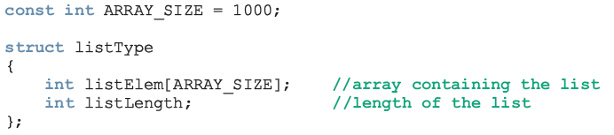
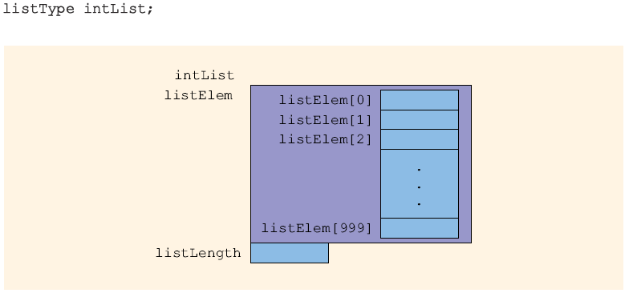
Arrays in structs

Slide 16
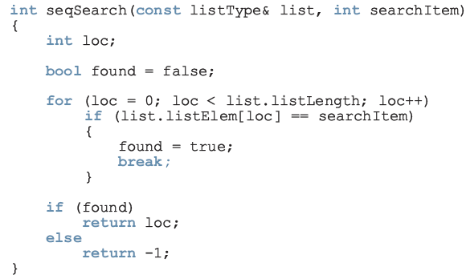

Slide 17
Arrays in structs contd.
struct StudentReport
{
string st_name;
int marks[5]; //stores marks of 5 courses
char grade[5]; //grades of 5 courses
};
void ReadReport(StudentReport &s)
{
cout<<"\nEnter Student's name: ";
cin>>s.st_name;
for(int i=0; i<5; i++)
{
cout<<"\nEnter Marks of all courses ";
cin>>s.marks[i];
s.grade[i]=Calc_Grade(s.marks[i]);
}
}

Slide 18
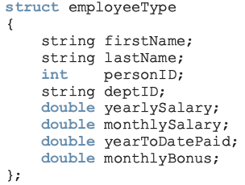
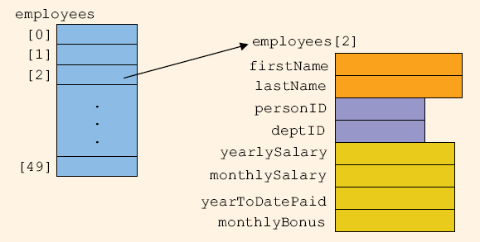
Struct in Arrays

Slide 19
Struct in Arrays contd.
struct StudentReport
{
string st_name;
int marks[5]; //stores marks of 5 courses
char grade[5]; //grades of 5 courses
};
void ReadReport(StudentReport &s);
void PrintReport(StudentReport s);
void main(){
StudentReport s[10];
for(int i=0; i<10; i++){
ReadReport (s[ i ] );
PrintReport (s[ i ] );
}
}
To store data of 10 students

Slide 20
Modifying readReport function using Filestreams
Let us assume we want to read data from file.
Implementation # 1 (Read data for all students)
void ReadReport(StudentReport s[], int NoOfStudents)
{
ifstream ifile;
int i=0;
ifile.open(“InputFile.txt”);
while(!ifile.eof()
{
if(i<NoOfStudents){
ifile>>s[i].st_name;
for(int j=0; j<5; j++)
{
ifile>>s[i].marks[j];
S[i].grade[j]=Calc_Grade(s[i].marks[j]);
}
i++;
}
}
void main(){
StudentReport s[10];
ReadReport (s, 10);
}

Slide 21
Input.txt
Name1 12 100 90 60 76
Name2 45 78 88 98 99

Slide 22
Implementation # 2 (Read data for one student at a time)
void ReadReport(ifstream & ifile, StudentReport &s)
{ifile>>s.st_name;
for(int j=0; j<5; j++){
ifile>>s.marks[j];
S.grade[j]=Calc_Grade(s.marks[j]);}}
void main(){
StudentReport s[10];
ifstream ifile;
ifile.open(“input.txt”);
for (int i=0 ; i <10; i++)
ReadReport (ifile, s[ i ] );
}
void main(){
StudentReport s[10];
ifstream ifile;
ifile.open(“input.txt”);
int i=0;
while(!infile.eof(){
ReadReport (ifile, s[ i ] );
i++;
}
}
OR

